Slide 1
DELPHI: Distributed, Extremely Low-Power Hardware Inference
Megan Chhu
Trenton Elliott
Michael Shires

Slide 2
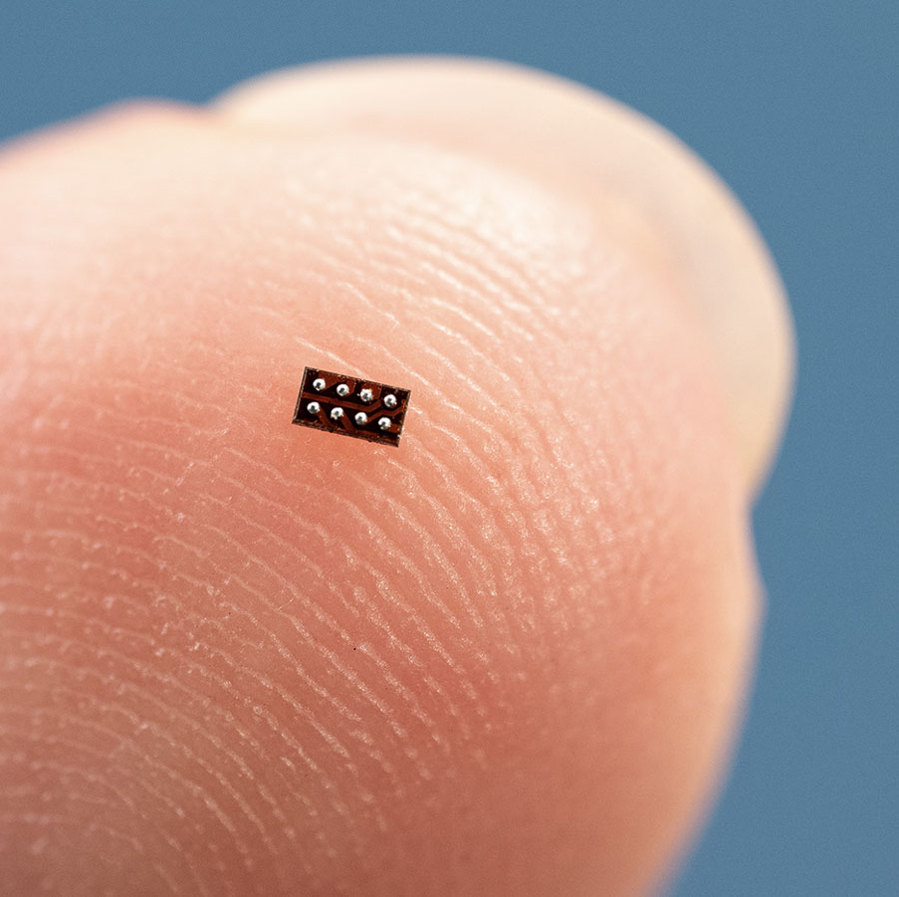
Platform: Arm Cortex M0+
Worlds smallest MCU core
Floor plan of 1.6mm x 2mm
Example usage – Key word spotting
(MSPM0C1104)

Slide 3
Research Questions
1. What type of performance impact do we see when distributing a model layer across multiple chips?
2. What types of models could this application benefit from? (Ex. Textiles)
3. Is it feasible to distribute a model layer across multiple chips?

Slide 4
Model
3-Layer KWS model trained on "speech_command" from Tensorflow
Identifies the key word "yes"
Weights and biases extracted from model via Netron, and put into C software to directly program chips or FPGA

Slide 5
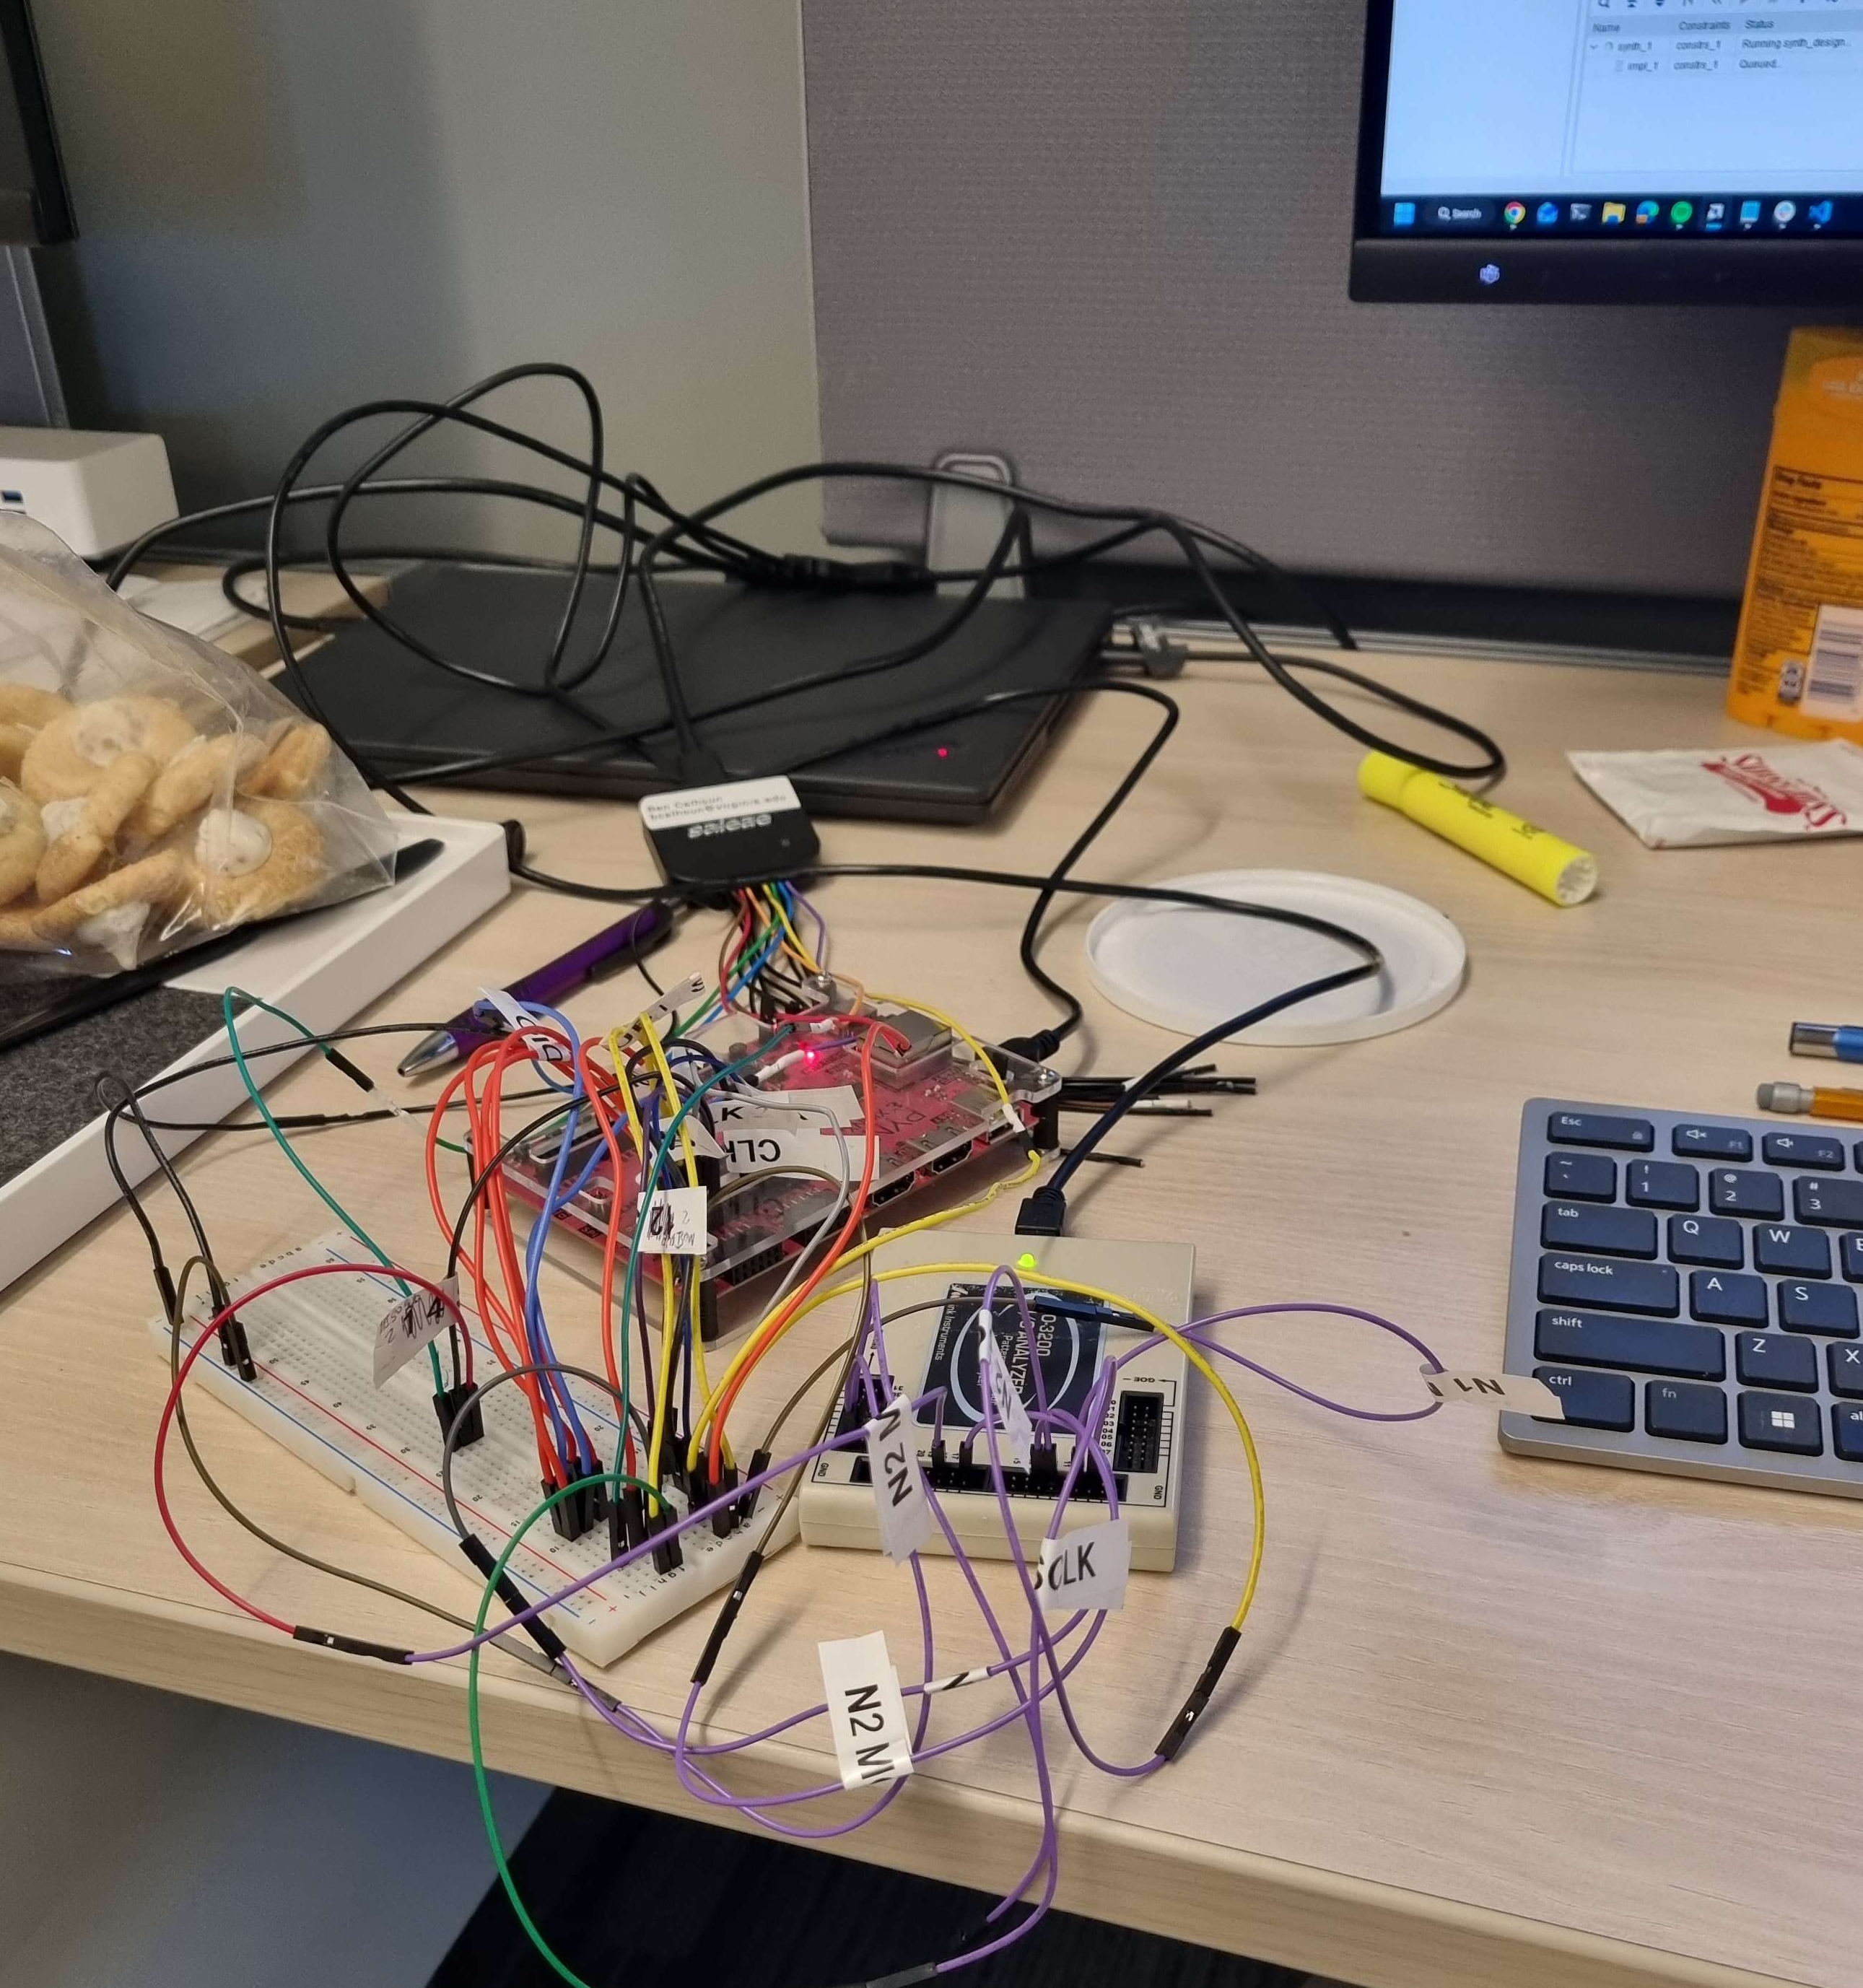
FPGA and PCB
Currently use a PYNQ Z1 board to emulate two ARM M0+ chips and networking connections.
Custom PCB board provided by Robust VLSI Design Lab with chip sockets
Generic NodeC verilog wrapped with custom wiring connections to represent a physical setup

Slide 6
Input and Communication
Input audio is transformed into the frequency domain using Mel-Frequency Cepstral Coefficients (MFCC)
This is also the data format of the "speech_commands" dataset from TensorFlow
This is an array of 50 FP32 values which represents one word, "yes".
Communication between chips is monitored and inspected via a Logic Analyzer (Saleae)
Networking protocol incorporates:
Clock signal provided by the transmitter
Handshake initiating and ending a packet transmission
Data signal provided by the transmitter
Notes:
So for input to the model and communication between the chips, the input audio is transformed into the frequency domain to produce an array of 50 floating point values, which are known as it’s MFCC.
Once the first chip is done processing, it sends it data via a bus to the second chip, and a logic analyzer is used to read this bus and make sure the model is working.
We created a low overhead communication protocol to transport these floating point values between chips. This protocol is clocked by the transmitting chip, and uses a handshake for the beginning and end of a packet.

Slide 7
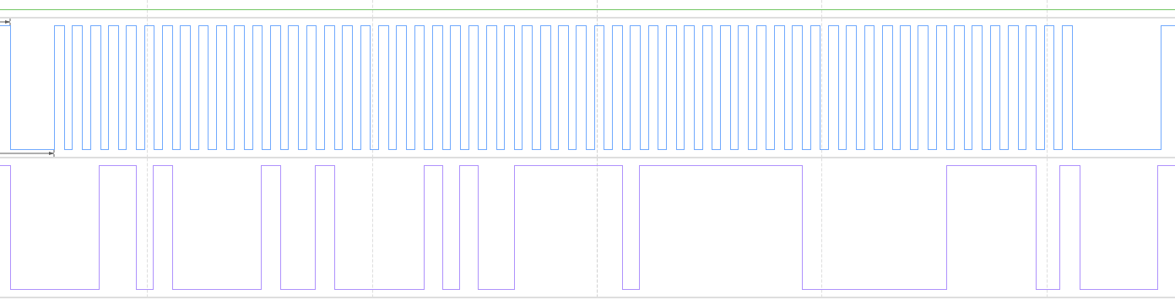
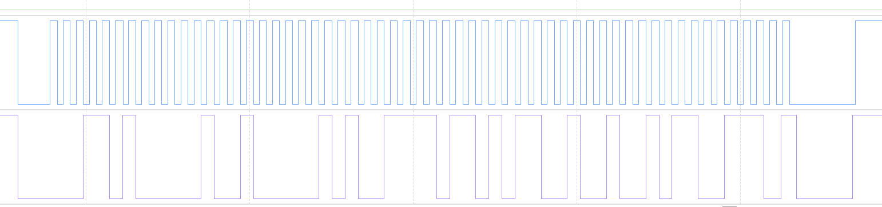





Results from FPGA
(0x3f7fc03e)
0.9990 in FP32 - "Yes"
(0x3dac710d)
0.0842 in FP32 – Failure (not "Yes")

Slide 8
Research questions answered
Overall, emulation on an FPGA was successful, with a ~0.1ms delay for communication between chips
This technique can be used to spread deeper learning models across distributed components at the edge – identification of animals on distributed wilderness cameras for example.
Distributing the neural network introduces new physical threat vectors, which reduces the reliability of the system. We observed this when attempting to shift to physical hardware.

Slide 9
Future Work
Implement on physical hardware (ARM M0+ vs. PYNQ Z1 FPGA)
Evaluate 3-chip configuration and determine tradeoffs of:
Power
Latency
Accuracy
Evaluate larger chip configuration

